Slide 1

CSE- 208
Algorithm Lab
Lab: 05
DAC
Fahad Ahmed
Lecturer, Dept. of CSE
E-mail: fahadahmed@uap-bd.edu

Slide 2
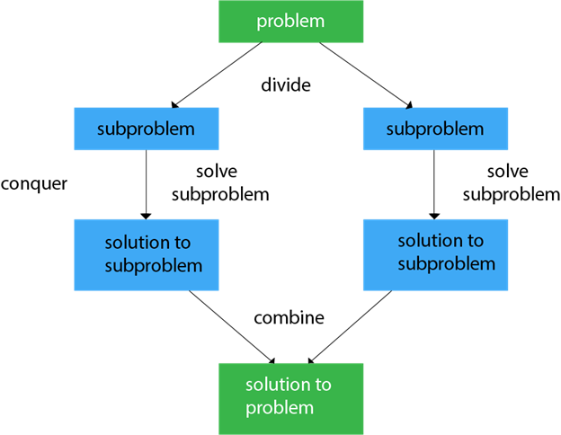
Divide and Conquer

Slide 3
Maximum Subarray -Brute Force algorithm
3 | -1 | 6 | -2
SUM
3
3
2
3 | -1
8
3 | -1 | 6
6
3 | -1 | 6 | -2

Slide 4
Maximum Subarray -Brute Force algorithm
int maxSubarraySum ( int A [] , int n)
{
int max_sum = 0
for(i = 0 to n-1)
{
for(j = i to n-1)
{
int sum = 0
for(k = i to j)
sum = sum + A[k]
if(sum > max_sum)
max_sum = sum
}
}
return max_sum
}
Time Complexity - O(n³)

Slide 5
Maximum Subarray -Brute Force algorithm
3 | -1 | 6 | -2
SUM
3
3
2
3
 | -1
8
 | 6
2
6
8
 | -2

Slide 6
Maximum Subarray –Improvised Brute Force algorithm
int max_Subarray_Sum ( int A[] , int n)
{
int max_sum = 0
for ( i = 0 to n-1)
{
sum=0
for( j = i to n-1)
{
sum = sum + A[j]
if (sum > max_sum)
max_sum = sum
}
}
retun max_sum
}
Time Complexity - O(n²)

Slide 7
Maximum Subarray–
Is it necessary to iterate the inner loop until the end?
Could we determine a definitive point, iterating past which wouldn’t lead to the correct answer?

Slide 8
Maximum Subarray– divide & conquer
You could divide the array into two equal parts and then recursively find the maximum subarray sum of the left part and the right part.
But what if the actual subarray with maximum sum is formed of some elements from the left and some elements from the right?

Slide 9
Maximum Subarray– divide & conquer
The sub-array we’re looking for can be in only one of three places:
On the left part of the array (between 0 and the mid)
On the right part of the array (between the mid + 1 and the end)
Somewhere crossing the midpoint.
You could very easily find a cross-sum of elements from the left side and right side which cross the mid-element in linear time.

Slide 10
Maximum Subarray– divide & conquer
Solution Steps
Divide the array into two equal parts
Recursively calculate the maximum sum for left and right subarray
To find cross-sum:-
Iterate from mid to the starting part of the left subarray and at every point, check the maximum possible sum till that point and store in the parameter lsum.
Iterate from mid+1 to the ending point of right subarray and at every point, check the maximum possible sum till that point and store in the parameter rsum.
Add lsum and rsum to get the cross-sum
4. Return the maximum among (left, right, cross-sum)

Slide 11
Maximum Subarray–divide & conquer
3 | -1 | 6 | -2
3 | -1
6 | -2
MSS =3
MSS =6
Divide the array to 2 subarrays.
Find the MSS of 2 subarrays.
Also need the find the MSS that crosses the 2 subarrays.
Combine the Solution.

Slide 12
Maximum Subarray–divide & conquer
MSS =8
3 | -1 | 6 | -2
3 | -1
6 | -2
MSS =3
MSS =6
Combine the solution
MSS of the whole array could be
Entirely in left subarray, or
Entirely in right subarray, or
crossing the midpoint, some part lie in left subarray and the remaining in right

Slide 13
Maximum Subarray–divide & conquer
MSS =8
3 | -1 | 6 | -2
3 | -1
6 | -2
MSS =3
MSS =6
Combine the Solution.
MSS of the whole array would be the biggest MSS among three(left, right an cross)

Slide 14
Maximum Subarray– divide & conquer
int maxSubarraySum (int A[], int low, int high)
{
if (low == high)
return A[low]
else
{
int mid = low + (high - low)/2
int left_sum = maxSubarraySum (A, low, mid)
int right_sum = maxSubarraySum (A, mid+1, high)
int crossing_Sum = maxCrossingSum(A, low, mid, high)
return max (left_sum, right_sum, crossing_Sum)
}
}

Slide 15
Maximum Subarray– divide & conquer
int maxCrossingSum(int A[], int l, int mid, int r)
{
int sum = 0
int lsum = INT_MIN
for(i = mid to l)
{
sum = sum + A[i]
If (sum > lsum)
lsum = sum
}
sum = 0
int rsum = INT_MIN
for(i = mid+1 to r)
{
sum = sum + A[i]
If (sum > rsum)
rsum = sum
}
return (lsum + rsum)
}

Slide 16
Maximum Subarray
Efficient solutions
Five solutions for this problem:-
Brute force approach I : Using 3 nested loops
Brute force approach II : Using 2 nested loops
Divide and Conquer approach : Similar to merge sort
Dynamic Programming Approach I : Using an auxiliary array
Dynamic Programming Approach II : Kadanes's Algorithm

Slide 17

Thanks to All

